Slide 1
Security Standards
Group 1- loadedwithstuff.co.uk

Slide 2
Assumptions made loadedwithstuff.co.uk
Payments can be made directly on the website and does not integrate with a third-party company for payment processing.
The e-commerce website provider stores and manages the user data.
The Company operates and delivers products worldwide.

Slide 3
Applied standards to the website loadedwithstuff.co.uk
GDPR
Website allows account creation for users
Delivery information such as names and addresses are required.
PCI Security Standards
Payments are processed through the website.
ICO
Company is based and operates in the UK.

Slide 4
GDPR standards loadedwithstuff.co.uk
Lawfulness, fairness and transparency
Purpose limitation
Data minimisation
Does the website only ask for relevant information?
Accuracy
Storage limitation
Integrity and confidentiality (security)
Is the data encrypted?
Is there a password policy?
Accountability

Slide 5
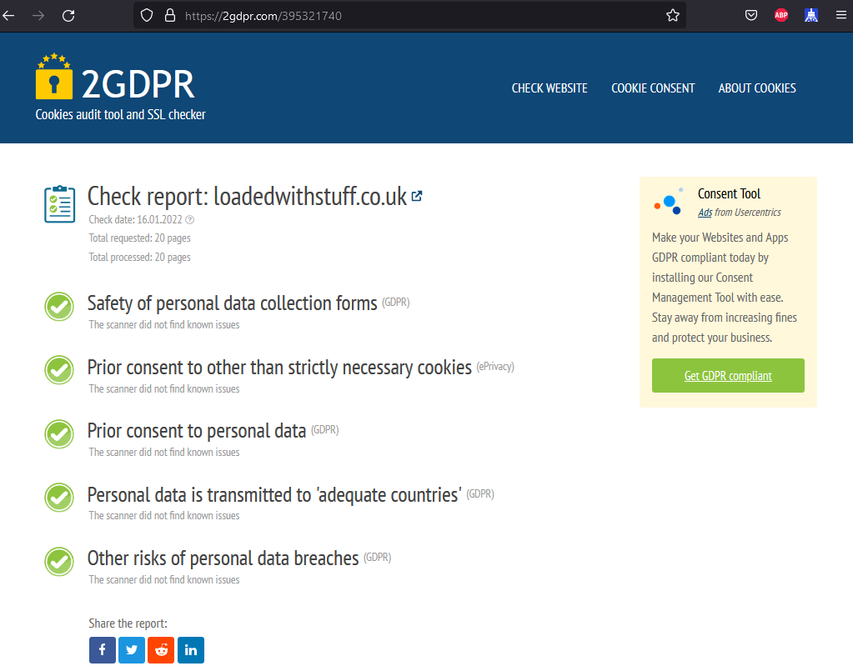
GDPR Standards Check loadedwithstuff.co.uk
2gdpr.com (2022)

Slide 6
PCI-SSC standards loadedwithstuff.co.uk
How to determine website compliancy:
“There is only one way for a consumer to tell if a website is PCI compliant. If the website accepts credit card payments, it is compliant. If the site sells merchandise and does not accept payment, it is not compliant.”(Torpey, n.d.)
Compliant: Non-Compliant:
American Express - PayPal
MasterCard
Visa

Slide 7
PCI-SSC Standards loadedwithstuff.co.uk
PIN Transcation Security Point of Interaction (PTS POI)
Is the payment website protected against espionage?
Payment Application Data Security Standard (PA-DSS)
Which payment methods are used?
PTS Hardware Security Module (HSM)
Point-to-Point Encryption (P2PE)
Is encryption in use? Does the encryption offer sufficient protection?
PCI 3.D Secure Software Development Kit (3DS SDK)
Is a current Secure Software Development Kit being used?
Software-based PIN Entry on COTS (SPoC)
Secure Software
What software is in use? Is the software up to date?
Secure Software LifeCycle (Secure SLC)
Contactless Payments on COTS (CPoC)

Slide 8
Recommendations loadedwithstuff.co.uk
Use of up-to-date firewall configuration
Strong password policy
Protected storage of user information
Encrypted transmission across open networks
Restrict physical access to database
Monitoring of all access to network resources
Regular penetration testing of security systems
Implement a least privilege policy
Implementation of Multi-Factor Authentication (MFA)

Slide 9
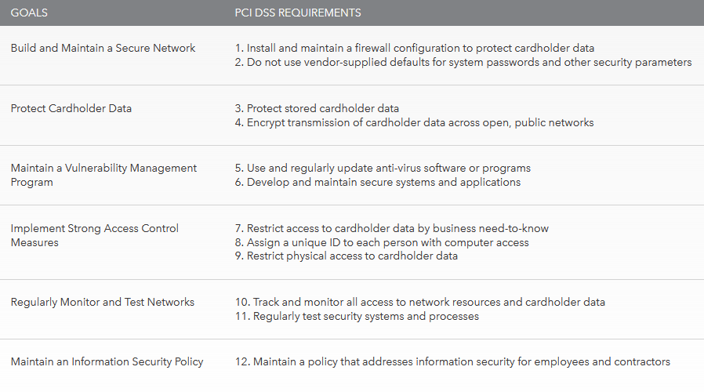
Recommendations loadedwithstuff.co.uk
According to PCI (2022):

Slide 10
References: loadedwithstuff.co.uk
ICO (2021). Information Commissioners Office – Guide to the General Data Protection Regulation – Security. Available from: https://ico.org.uk/for-organisations/guide-to-data-protection/guide-to-the-general-data-protection-regulation-gdpr/security [Accessed 09 December 2021]
Torpey, J. (n.d) How Do I Tell If a Website Is PCI Compliant. It Still Works. Available from: https://itstillworks.com/do-tell-website-pci-compliant-5968912.html [Accessed: 17.01.2022]
2GDPR (2022) Cookies audit tool and SSL checker. Available from: https://2gdpr.com/ [Accessed:16.01.2022]
PCI (2022) PCI Security Standards Overview. Security Standards Council. Available from: https://www.pcisecuritystandards.org/pci_security/standards_overview [Accessed: 16.01.2022]
PCI (2022) Maintaining Payment Security. Security Standards Council. Available from: https://www.pcisecuritystandards.org/pci_security/maintaining_payment_security [Accessed: 17.01.2022]

